Slide 1
Logistic Regression
Mitch Strahlman
June 2020

Slide 2
Outline
Data
Data Cleaning
Data Examination
Descriptive Statistics
Data Preparation
Logistic Regression Model
Confusion Matrix
Insights
Code

Slide 3
Data
Data shows distribution of 1607 currently married and fecund women interviewed in a Fiji Fertility Study
Demographics
Age (< 25, 25 - 29, 30 - 39, 40 - 49)
Education Level (no education, some education)
Desire for more Children (wants more, does not want more)
Current Use of Contraception (uses, does not use)
All data was imported, cleaned, modeled, and visualized in RStudio

Slide 4
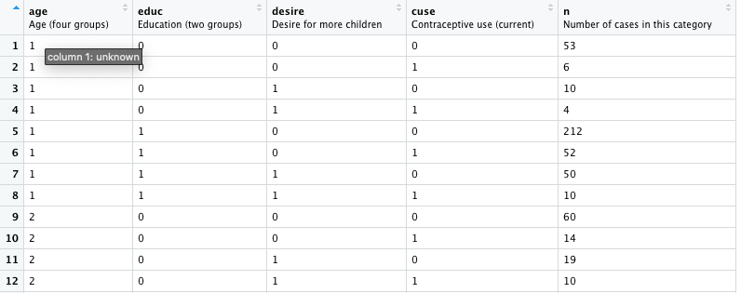
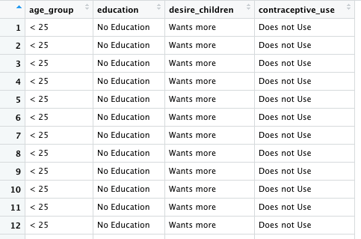
Data Cleaning
The n column was expanded and integrated into the other columns, so that each row represented a single survey respondent
Each variable (all categorical) was converted to a factor
Column titles and factor levels were renamed for readability

Slide 5
Data Examination
Descriptive tables were created to detect whether there was representation within each demographic
Contraceptive Use x Age Group
 | Age Group
Contraceptive Use | < 25 | 25 - 29 | 30 - 39 | 40 - 49
Uses | 325 | 299 | 375 | 101
Does Not Use | 72 | 105 | 237 | 93
Contraceptive Use x Education Level
 | Education Level
Contraceptive Use | None | Some
Uses | 412 | 688
Does Not Use | 201 | 306
Contraceptive Use x Desire for Children
 | Desire for Children
Contraceptive Use | Wants More | Does not Want More
Uses | 753 | 347
Does Not Use | 219 | 288

Slide 6
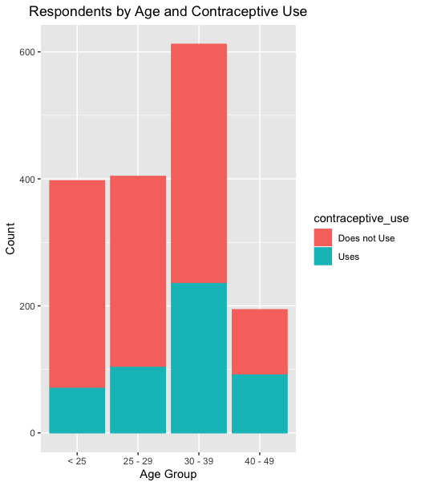
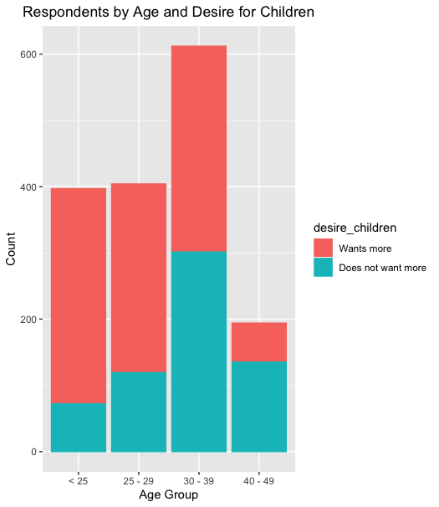
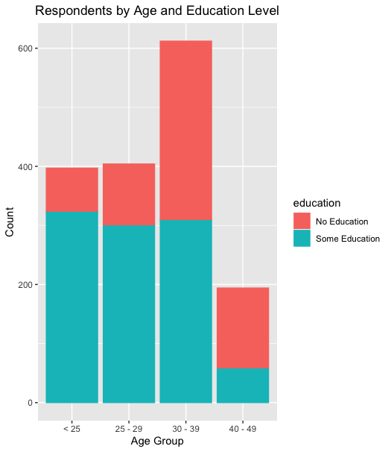
Descriptive Statistics

Slide 7

Data Preparation
Training and test subsets were created in order to create a post-test confusion matrix
75% of data = training
25% of data = test

Slide 8
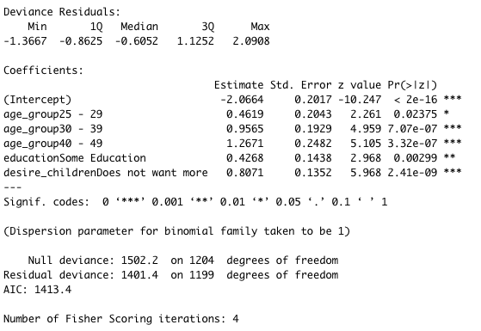
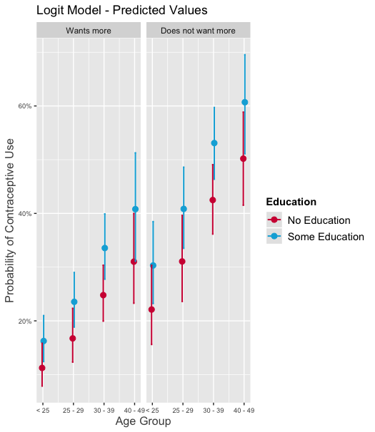
Logistic Regression Model
Contraceptive Use = -2.06 + .46(25 – 29 AG) + .96(20-39 AG) + 1.23(40 – 49 AG) + .43(Some Education) + .81(No more Children)
All reported independent variables are significant

Slide 9
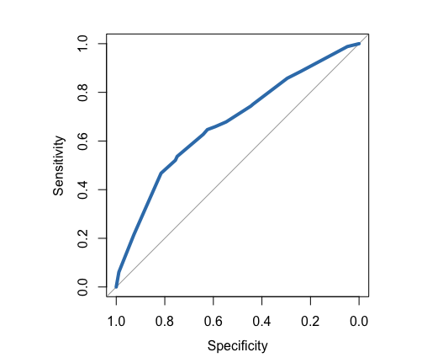
ROC Curve & Confusion Matrix
Confusion Matrix
Contraceptive Use | False | True
Does not Use | 209 | 66
Uses | 58 | 69
Threshold: .356
Determined through the Youden method (maximizing the sum of the sensitivities and specificities) by using the coords() function
AUC: .6733
PPV: .54
NPV: .76
Specificity: .75
Sensitivity: .54

Slide 10
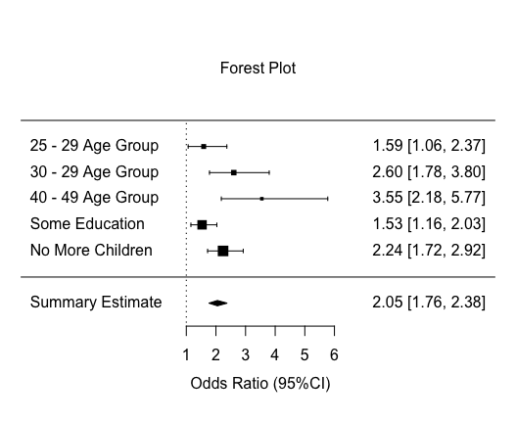
Insights
The odds of being on birth control associated with someone between the ages of 25 & 29 is 1.5871 when compared to the reference group (< 25)
The odds of being on birth control associated with someone between the ages of 30 & 39 is 2.6026 when compared to the reference group (< 25)
The odds of being on birth control associated with someone between the ages of 40 & 49 is 3.5502 when compared to the reference group (< 25)
The odds of being on birth control associated with someone who has some education is 1.5323 when compared to the reference group (no education)
The odds of being on birth control associated with someone who does not want more children is 2.2412 when compared to the reference group (wants more children)

Slide 11
GitHub Repository

